Slide 1

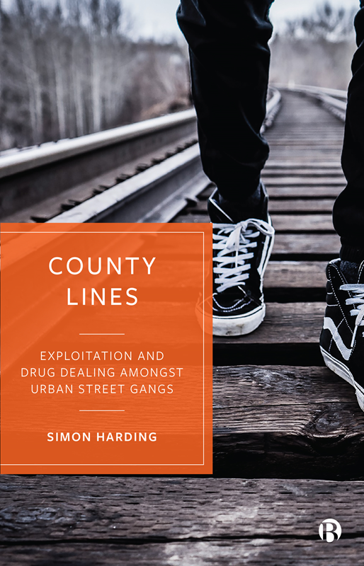
Competition, Exploitation and
Cuckooing in County Lines

Slide 2

County Lines
A business model
Adaptable
Professionalisation
Exploitation is variable
Control Repertoire
Criminal confidence and local change
Rupturing of user community equilibrium

Slide 3

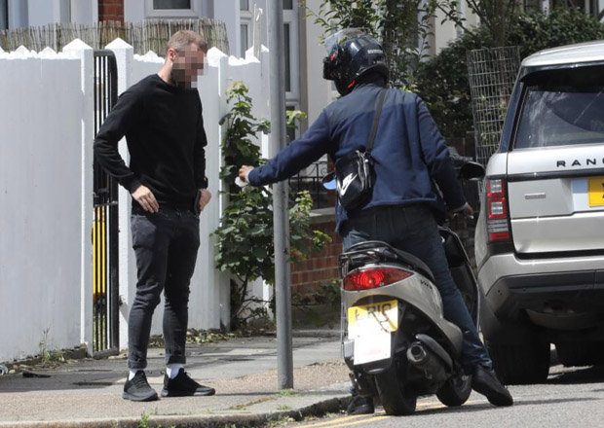
24 Hr Dial – A - Dealer
Competition to get drugs to user
Local supply changed
Gig economy
Door to door delivery
Mopeds
Drugs/money
Knives, weapons
Risk of targeted attacks
Deal beyond postcodes
= Saturated markets

Slide 4
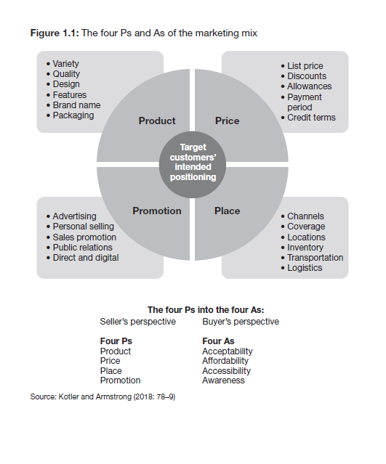
The 4 ‘Ps’ and ‘As’ of the marketing mix

Slide 5
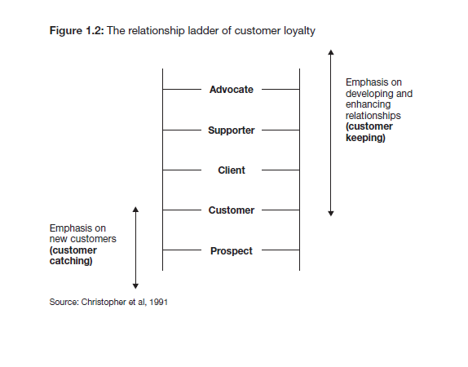
Customer validation in the ladder of customer loyalty

Slide 6
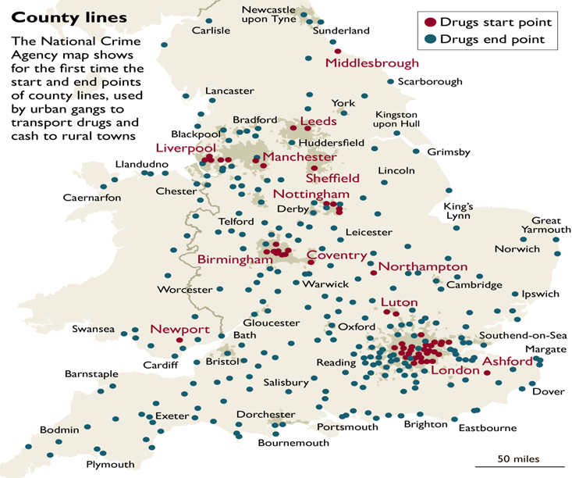
Building Competitive Advantage
Non-Saturated markets
Expand supply to country/coastal towns
Local domestic markets
for Heroin, Cocaine
2,500 lines in UK (NCA)

Slide 7
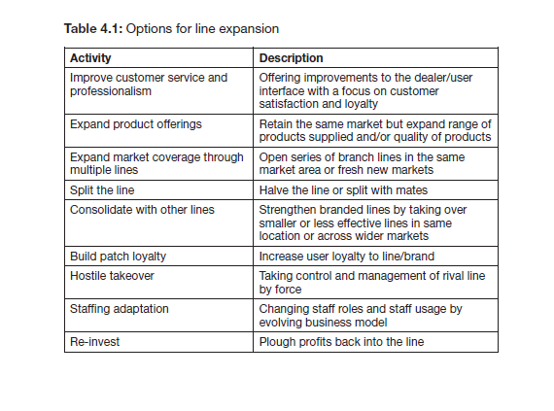
Options for line expansion

Slide 8

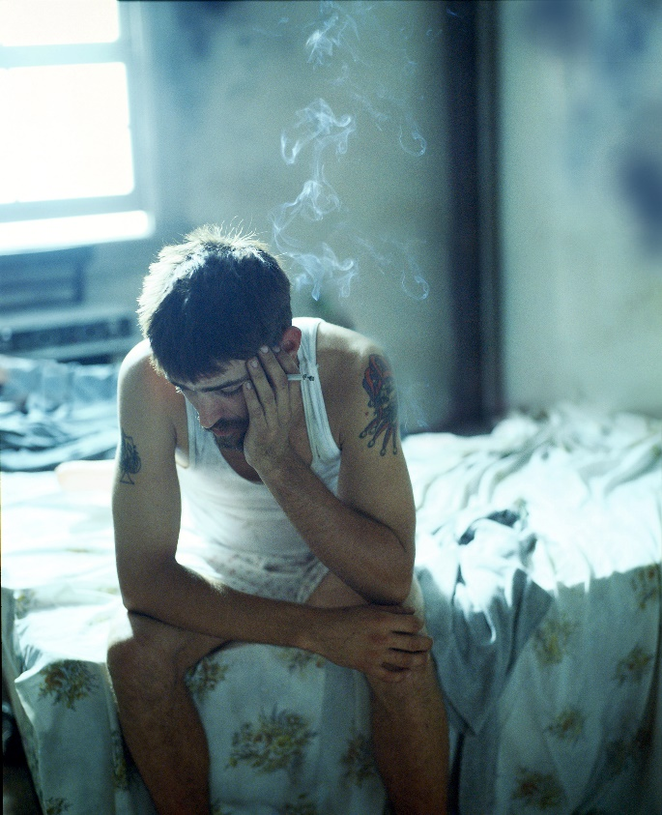
Reduce Business Costs
Intimidate/con/coerce
Deal from flat
3 days – 3 months
Change address
Take over property
Intimidate/con/coerce
Deal from flat
3 days – 3 months
Change address
Title of Slide
COMPETITIVE ADVANTAGE
cuckooing
Your text goes here

Slide 9
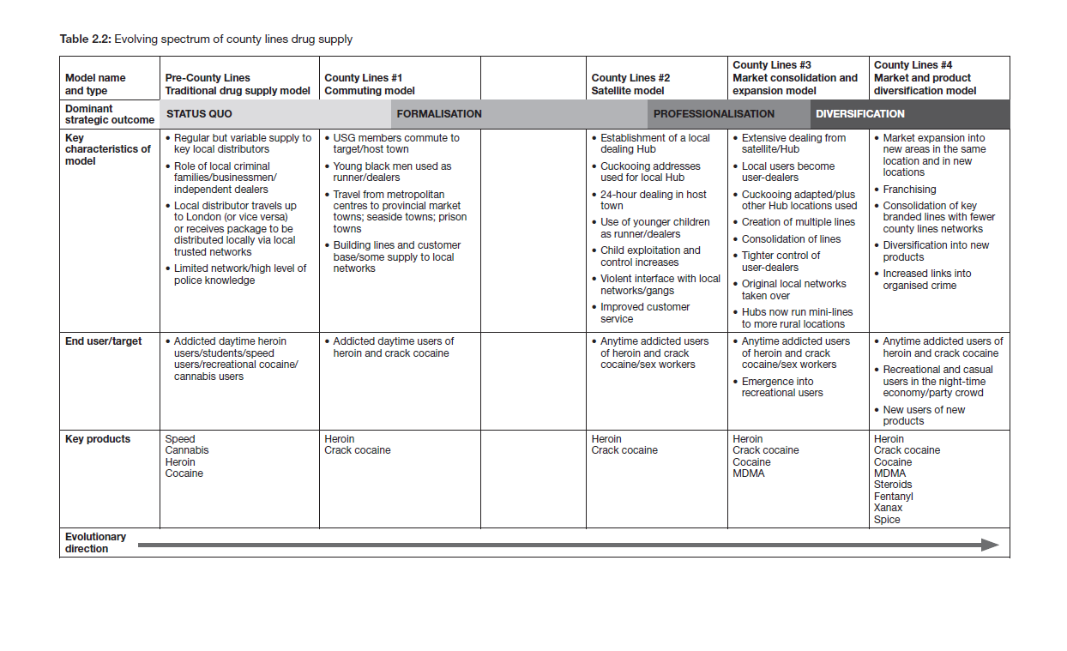
Evolving spectrum of County Lines

Slide 10
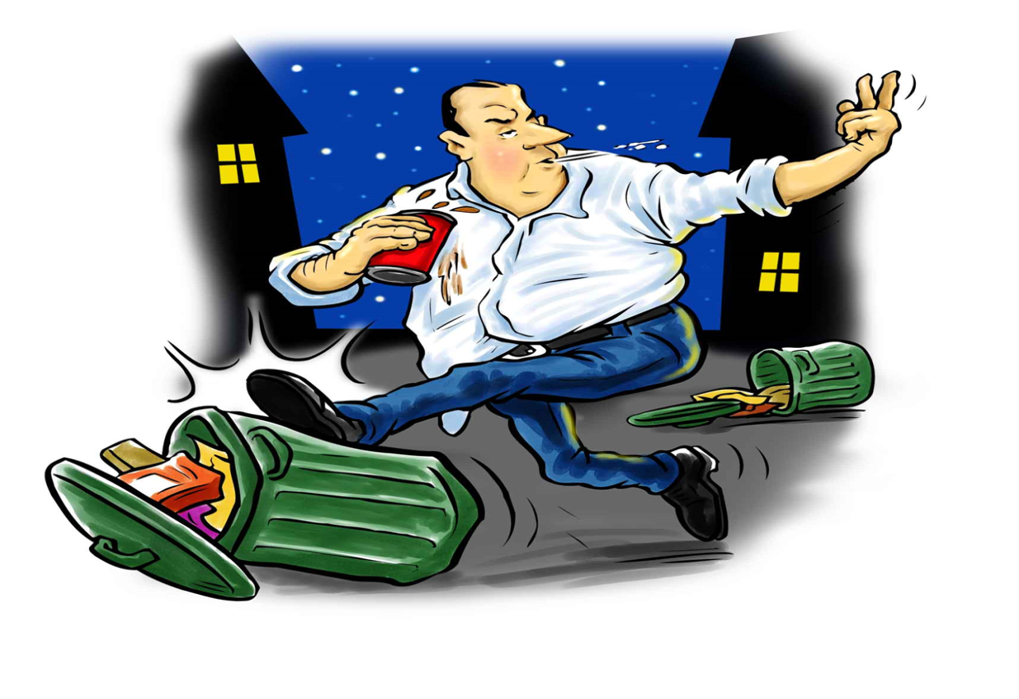
Pre-County Lines Traditional Model

Slide 11
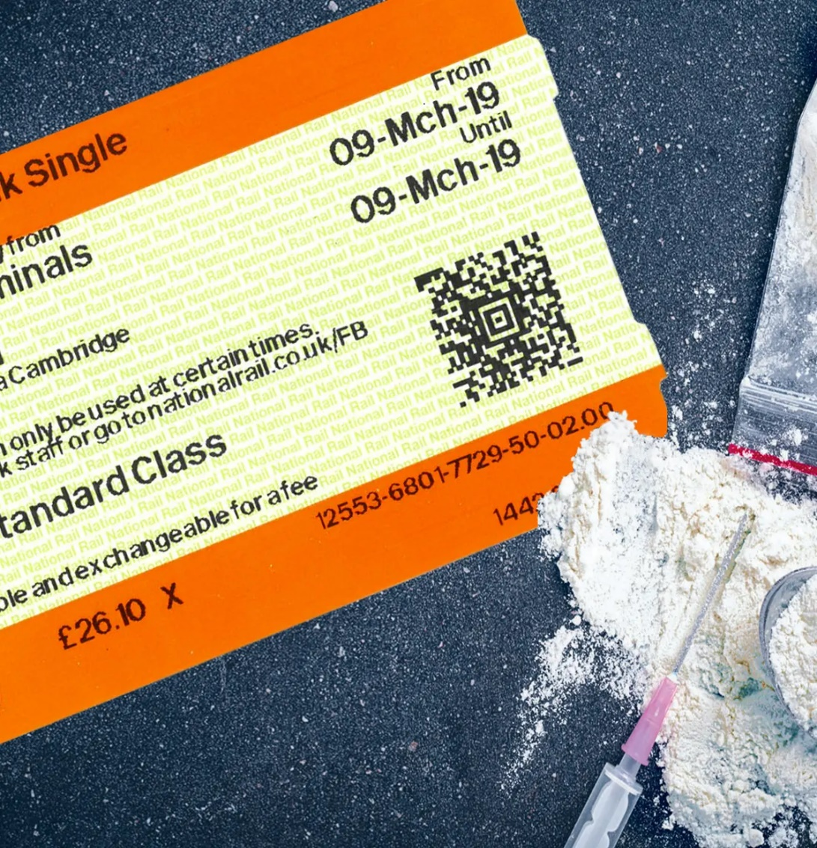
County Lines #1 – Commuting Model

Slide 12
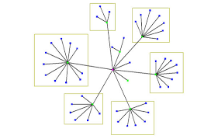
County Lines #2- Satellite Model

Slide 13

County Lines #3 Market Consolidation and Expansion Model

Slide 14
County Lines #4 Market and Product Diversification Model

Slide 15
Circle of violence, debt and profit
Demand
Parent Gang
Debt
Exploitation
Profit
Users
Violence and control
Dealers/ local managers
Profit
Profit
Debt
Debt
Runners

Slide 16
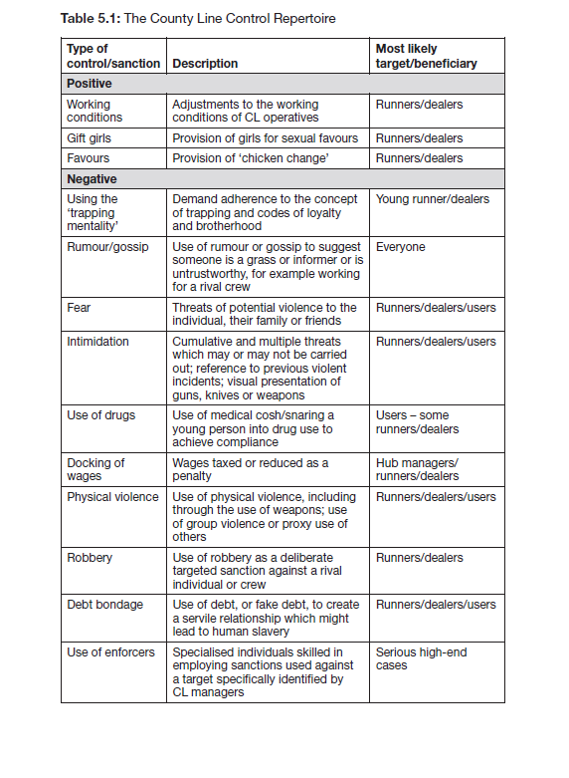
County Line Control Repertoire

Slide 17

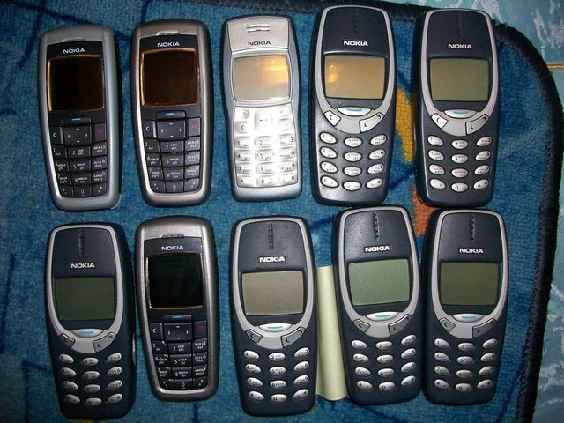
Remote Mothering

Slide 18
Cuckooing: Typology
Type | Scenario
Stealth – A ‘Tuesday Mate’ | Relationship built slowly over time; often used as a future, hedging bets arrangement should they be needed. A ‘Tuesday mate’ often appears each Tuesday when shopping is done or drugs are purchased.
Guile and fake friendship | Commonly used by identifying vulnerable targets in local cafes, health centres and benefit offices. This can be quick or over time. Inducements can be offered.
Tip-offs | Other users (seeking favours) will tip off dealers – can be done as revenge or power and control grab over the target
Passed on introductions | A more normalised introduction through regular interactions and transactions – often drugs offered/received for this
Coat-tailing | A dealer enters on the coat-tails of another user. Users become proxies for this type of entry.
Open Proposition | Sometimes used via cold-calling as the target will be on a burner phone database. Open propositions can be made when following someone home from a benefits office.
Enticement | Free drugs and take it or leave it deals for short term benefits are offered.
Tandem Working with Care staff | Tip off from local care workers. Usually targeted towards elderly with mental health issues

Slide 19
Cuckooing: Agentic User Responses
Type | Scenario
Compliance | Some users are complicit with dealers and so easily comply with all demands – usually due to the dividends obtained
Compromise | Some users accept a medicinal cosh or steady supply of drugs. Compromise can include paying of rent, free drugs or starting a sexual relationship
Complain | Users complain to other users/ family hoping that intelligence will eventually reach the authorities
Cash In | Some users make a conscious decision to cash in. Some may commence paid work for the dealer or work in lieu of drugs
Cast Off | Users pass the dealers off onto other more vulnerable users – often by claiming their own premises is now under police surveillance
Calling In | Users call in to visit housing or agency staff to tell what is happening. Although often a sign of vulnerability – it is still an agentic move
Conspiring | Users conspire with rivals dealers to get the property raided. This can be high risk
Counteracting | Users try to re-take the property by force. Again very high risk
Calling police | Direct informing brings risks of being branded a Snitch. Done either by direct informing or by ‘soft grassing’ including passing the keys to police.
Call it quits | Tenants leave property or request a transfer. Very disruptive to anyone in recovery
Capture | Users will deliberately get caught by police: permits intervention without being labelled a Grass

Slide 20
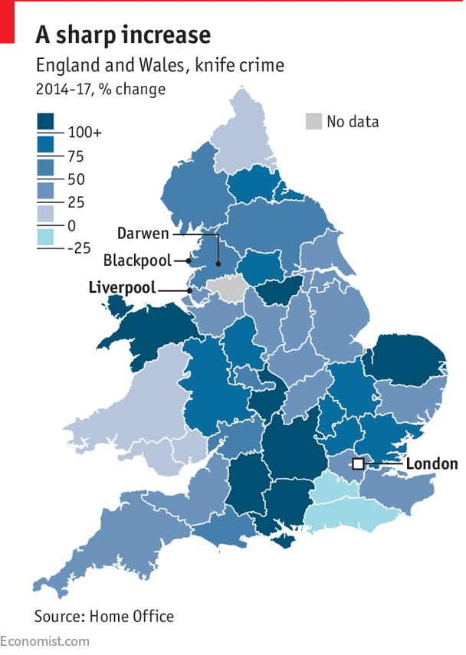
Biggest increase in knife crime outside cities, 2019

Slide 21
Rupturing of user community equilibrium
Disequilibrium = a state in which things are not stable or certain, but are likely to change suddenly. (Collins Dictionary)
Users can now be User-dealers
Some Users-dealers skim/cut deals, profit, exploit weaknesses
Creates new Hierarchy of Users – ‘superiority’ via role
Intell and information is collated, then traded with gangs
Others users feel at greater risk as intimate knowledge is shared
User-dealers more targeted by police
Distrust and suspicion grows
Gangs use Users for ‘proxy control’ – increase in knife attacks

Slide 22


