Slide 1


Tackling Cuckooing
DI Anne Rannard (NCLCC)

Slide 2
What is our plan?
Why Is Sec 45 Causing So Many Problems ?
Capturing work to tackle cuckooing to identify gaps in provision
Sharing best practice
Reviewing legislative options to tackle the use of vulnerability

Slide 3
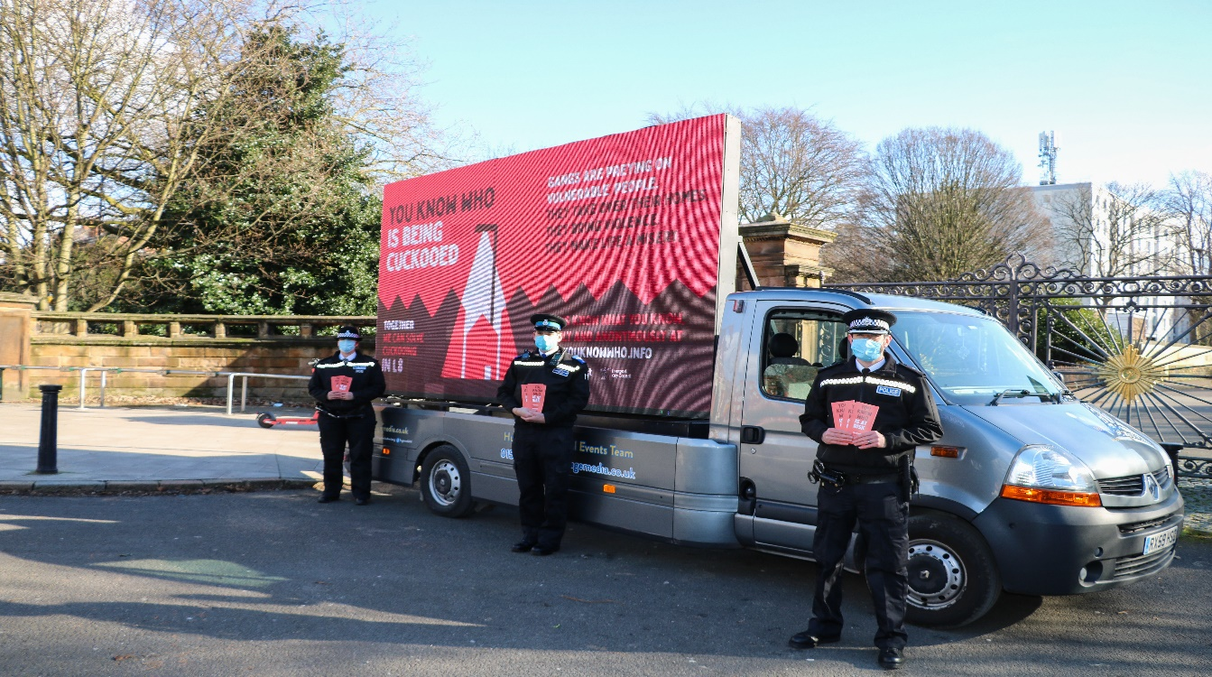
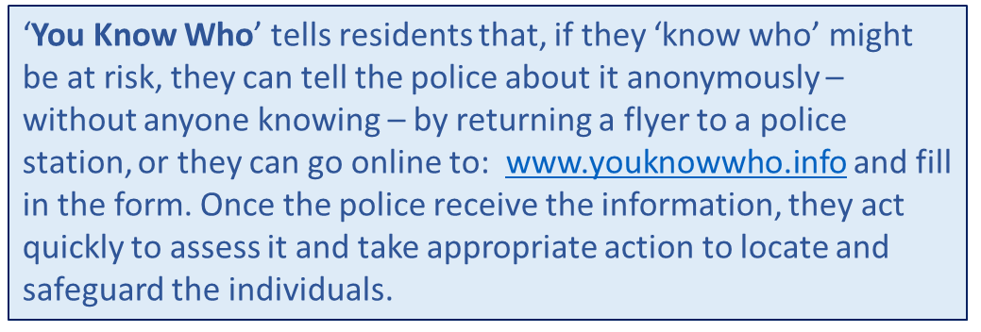
Best Practice
Why Is Sec 45 Causing So Many Problems ?
‘You Know who campaign’
Merseyside

Slide 4
Best Practice
Why Is Sec 45 Causing So Many Problems ?
IDENTIFY
CONSIDER OPTIONS
ATTENDANCE
FURTHER ACTION
Identify potential cuckooed victim / property from intelligence sources.
Consider the best way to deal with the information :
Single or joint agency visit?
Sufficient to justify a warrant?
Visit to property takes place. Attending officer is looking for signs of cuckooing.
2. Consider what immediate safeguarding is necessary.
3. Deal with any offences appropriately.
If cuckooing is disclosed or suspected, the resident is offered the opportunity to become part of Op Guardian and to work with the Police to address their vulnerability.

Slide 5
Best Practice
Why Is Sec 45 Causing So Many Problems ?
Red – When an address has been cuckooed and immediate safeguarding is required. Officers will attend the address daily and engage partners around safe guarding. Following 2 weeks and no further concerns the address with go to Amber and Green when suitable.
Amber – When there is intelligence suggesting an address has been cuckooed, regular patrols and multi-agency working is required to ensure safety of occupants. Visits will be 3 times a week to deter any activity.
Green – Following an address being cuckooed follow up visits are required for reassurance. This will continue for a month before being removed should there be no further concerns.
Notes:
RAG response plan, which is a traffic light system which enables ongoing safeguarding with partner agencies to help support victims:

Slide 6
Legislation
Why Is Sec 45 Causing So Many Problems ?
Closure Orders (S76 Anti-social Behaviour, Crime and Policing Act 2014)
Community Protection Notices (S43 Anti-social Behaviour, Crime and Policing Act 2014)
Modern Slavery Act 2015
Section 8 Misue of Drugs Act
Section 19 Misuse of Drugs Act 1971
Serious Crime Act 2007 – Sections 44/45 and 46
Serious Crime Act 2015 – participating in the activities of an OCG
Slavery Trafficking Orders
Criminal Behaviour Orders (S22 Anti-social Behaviour, Crime and Policing Act 2014)
Gang Injunctions (S34 Policing and Crime Act 2009)
Sentencing Act 2020
Notes:
It’s difficult to say how prevalent use of specific legislation is for cuckooing, mainly because forces do not record that information in a searchable format. As cuckooing is not an offence, crimes or crime related occurrences linked to cuckooing could be recorded as numerous different offences / themes – eg, ASB, criminal damage, assault, burglary etc…. I have worked with some forces to encourage them to start capturing that sort of data, but they are not mandated to do so.
Closure Orders (S76 Anti-social Behaviour, Crime and Policing Act 2014) – Issuing of closure notices in respect of premises associated with nuisance or disorder (can apply to cuckooed premises). The NCLCC generally encourages partial closure orders so that the cuckooed victim can remain in their home.
Community Protection Notices (S43 Anti-social Behaviour, Crime and Policing Act 2014) – issued by constable / local authority where there is persistent unreasonable anti-social behaviour that has a detrimental effect on the local community’s quality of life. (Written warning must be issued first). Requires an individual to act, or prohibit them from acting as described in the notice.
Modern Slavery Act 2015 – Could be suitable in some situations and most likely Section 1 in respect of holding the tenant in slavery, servitude, forced or compulsory labour. This is likely to rely upon victim testimony unless sufficient evidence exists to pursue an evidence led prosecution. There have been a couple of charges that we are aware of under Sect 1 for cuckooing related offences. There is a current Humberside case seeking to pursue a Sect 1 prosecution against offenders for cuckooing a vulnerable adult. Section 2 might be considered when juvenile runners for example are located in a cuckooed property. There is a possibility in the latter example that the tenant could be prosecuted for harboring or receiving a juvenile runner in their property. Notably, in Op Tyllian (North Wales County Lines case) a number of ‘cuckooed’ individuals were prosecuted in these circumstances – it was considered that there was a public interest to do so.
Section 8 Misue of Drugs Act – Occuipers etc, of premises to be punishable for permitting certain activities to take place there. A person commits and offence if, being the occupier or concerned in the management of any premises, he knowingly permits or suffers any of the following activities to take place on those premises, that is to say (a) producing or attempting to produce a controlled drug in contravention of Section 4(1) of this act; (b) supplying or attempting to supply a controlled drug to another in contravention of Sect 4(1) of this Act, or offering to supply a controlled drug to another in contravention of subsection 4(1); (c) preparing opium for smoking; (d) smoking cannabis, cannabis resin or prepared opium.
This legislation provides police with powers to issue warning notices, which if breached create an offence. They might be considered punitive against cuckooed victims but some forces who have used them claim that they have the desired effect of moving the cuckooers on by providing the tenant with a piece of paper they can show to their exploiters.
Section 19 Misuse of Drugs Act 1971 – Create an offence of inciting anyone to commit an offence under the Misuse of Drugs Act. This could be suitable legislation to use against exploiters in addition to other Misuse of Drugs Act offences and could enhance sentencing opportunities.
Serious Crime Act 2007 – Sections 44/45 and 46 – Encouraging or inciting a serious offence. Serious offences include drugs trafficking offences and therefore this could be suitable legislation to prosecute exploiters under if sufficient evidence exists. This could lead to enhanced sentencing and also potential for Serious Crime Prevention Orders on conviction.
Participating in the activities of an organised crime group; S45 Serious Crime Act 2015 – Creates a criminal offence whereby a person participates in activities advancing the criminality of an OCG or deliberately assists an OCG by not acting. The suspect must know or reasonably suspect that their actions will help an OCG (e.g. could apply to couriers who deny knowledge of what they are couriering). This legislation is more likely to be used to prosecute a tenant who allows their property to be used to facilitate county lines, but might be suitable in some circumstances (not all suspected cuckooed victims are victims).
Slavery Trafficking Orders – Prevention, Risk and interim orders could be sought in some situations and would act as a management and disruption tool against perpetrators.
Criminal Behaviour Orders (S22 Anti-social Behaviour, Crime and Policing Act 2014) – Obtained on conviction, requiring offenders to act, or prohibit them from acting as described in the order. These might be considered punitive against cuckooed victims but some forces who have used them claim that they have the desired effect of moving the cuckooers on by providing the tenant with a piece of paper they can show to their exploiters.
Gang Injunctions (S34 Policing and Crime Act 2009) – Determined on the balance of probabilities, the respondent (no need to be convicted), aged 14yrs or over, has engaged in or encouraged gang related violence or gang related drug-dealing activity.
Sentencing Act 2020 – I’ll need to look further into this to establish which part is relevant, but highlighting vulnerability and exploitation can lead to enhanced sentencing against offenders, which could include cuckooing vulnerable people.
If a Closure Order is sought, there are some challenges in terms of having sufficient evidence / intelligence to justify the necessity for an order to be granted. Essentially, if the nuisance or disorder element are missing, an order will not be appropriate.

Slide 7
Challenges
Cuckooing is not an offence
No national practice to record concerns about cuckooing
Vulnerability and exploitation is not always identified
Pockets of good practice very much reliant on individuals rather than process
Sharing information
Provision to support victims
Notes:
The biggest single barrier in responding to cuckooing is disclosure regarding cuckooing taking place in a property. Generally, the tenant will not make a disclosure given potential risk to their safety and drug supply. It can also be difficult to determine whether the tenant is a victim or suspect without their disclosure. In most instances police will need to treat them as a suspect to avoid the tenant looking like an informant, but they may not be prosecuted. Essentially, the same challenges exist in respect of cuckooing as for child criminal exploitation. Quite often we are reliant on a disclosure from the victim to pursue a prosecution for the likes of Modern Slavery offences, unless we can pursue an evidence led prosecution.
Powers of entry - if we enter a premises lawfully and cannot identify any offences to support arrests, but we suspect that there are people in the premises who are cuckooing the property, we have no power to remove them.
In terms of powers of entry, police are limited to our powers of entry under:
Powers under PACE – Sect 17 – saving life and limb, Sect 19, Sect 32, Sect 18 etc….. ,
Common Law power of entry is a statutory right to legally enter defined premises, such as businesses, vehicles or land for specific purposes,
Warrant – eg, 23 Misuse of Drugs Act 1971 provides police with the power to search persons for controlled drugs and detain for the purpose of search if they have reasonable cause to suspect unlawful possession and Sect 8 PACE.
Essentially, unless these powers apply, we have no other grounds to enter a property unless we accompany other agencies who might have a power of entry.
When the police are presented with information regarding cuckooing, there is varying practice regarding how that information is dealt with and who deals with it. In the majority of cuckooing initiatives that exist nationally, it’s generally a case of reviewing the information, comparing against intelligence systems, perhaps information sharing with partner agencies and checking against their systems, with a view to deciding upon the best course of action in the circumstances. The response could be anything from a warrant, through to just a visit from Police to try and establish what is going on and offer support and advice to the tenant. Any of the legislation / options under question 1 mentioned earlier might be considered as a response. A Closure Order may not be considered the best response.

