Slide 1
Preventing Cuckooing and Exploitation
Louise Crowder

Slide 2
Who are we?
Arm's Length Management Organisation (ALMO)
Manage 12,000 properties for Stockport Metropolitan Borough Council
Largest Housing Association within Stockport
Delegated powers to take Civil action.
Notes:
However we tackle ASB in the private sector also, and cuckooing

Slide 3
Who am I?
Manage the Safer Neighbourhood officers
Cuckooing and exploitation Officer
17 people on the team
1 Head of Service
8 Safer Neighbourhood Officers
1 Complainant Support Officer
1 Neighbourhood Resolutions Officer
2 Case Support Officers
3 Managers
1 Tenancy fraud officer
Notes:
The whole team​ -
1 head of service​
8 Sno’s​
1 complainant support officer​
1 neighbourhood resolutions officer​
2 case support officers​
3 managers

Slide 4
Objectives
Establish an increased understanding of the extent of the problem of cuckooing in Stockport
Provide an immediate support system to victims of cuckooing
Provide harm reduction and facilitate access to substance misuse treatment, wider health services, support, and recovery for victims
Support the victim within with the criminal justice process
Support GMP or Council with partial or full Closure Orders if necessary
Prepare other civil enforcement action including but not limited to Civil Injunctions.
Notes:
The whole team​ -
1 head of service​
8 Sno’s​
1 complainant support officer​
1 neighbourhood resolutions officer​
2 case support officers​
3 managers

Slide 5
Cuckooing in Stockport - Establish an increased understanding ​of the extent of the problem of cuckooing ​
2020
2021
2022
Made more aware of the phenomenon of cuckooing
Stockport Homes Group and Greater Manchester Police campaign began
Established a need for a Dedicated officer to support victims
Funding approved from Safer Stockport partnership and SHG Homeless prevention fund.
18-month tenure neutral pilot project
Project Commenced January
Officer works with Greater Manchester Police along with external and internal teams.
Notes:
This is continuing and we are hoping to make this a permanent position.​
Talk about the cases on Lancashire hill ​
We provided sound intel to Operation Challenger as victims were too afraid to speak with GMP direct.​
This intel enabled GMP to execute warrants on 4 properties after 12 months of intel gathering​
Victims perps aged 15-23​
Victims 44-68​

Slide 6
Victims of cuckooing - Provide an immediate ​ support system​
Visiting clients in custody
Providing ’pay-as-you-go’ phones
Advice given regarding housing, Target hardening, SHP, support to flee and emergency accommodation
Providing a safe environment to be able to speak out to GMP or providing GMP with anonymous information if too scared to speak out.
Accompanying victims for support with drug and alcohol misuse, GP appointments.
Visiting the property on a regular basis, 2-3 times per week
Leaflet 4x4 ​
Refer to National referral mechanism (NRM).
Notes:
SHP – special housing panel for moves in stockport.​
Target hardening securing the property​
​
Drug and alcohol misuse – man that got used to test drug strength on. Aged 15-17 victim 76​
​
Visiting 2-3 times is disruptive to the perps, we tell anyone in there to leave as private appointment​
​
Leaflet 4x4 we drop letters to properties 4 up/down/across to highlight cuckooing in the area and signs to look out for and to come forward.

Slide 7
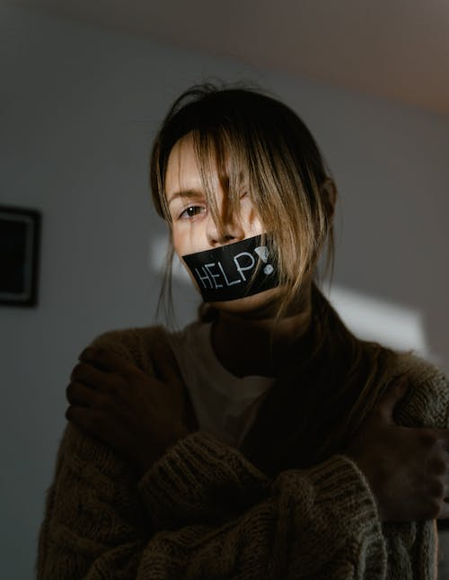
Support
Keep the victim in their home
Supporting the victim through criminal charges
Partial closure (if needed)
Intel continued to be shared
Secure the home (such as repairs)
Install CCTV
Notes:
Victim in home, support services, families helpful​
​
Partial closure, explain​
​
CCTV monitor who goes in or out​
When safe continue with monthly, bi monthly or quarterly meetings
​
​

Slide 8
Hidden Victims
Victim’s suffering is often hidden from view, or they don’t recognise themselves as exploited or controlled
At present, there is no specific criminal offence for cuckooing and victims are often fearful to speak out for fear of making the situation worse
The victim is often charged with an offence of possession with intent to supply, due to the drugs being found in their property
It is therefore vital that a cross-section of professionals work together effectively to help identify & manage the problem.
Notes:
Discuss Lincoln towers

Slide 9
Referrals
69
17
2
12
1
Notes:
Housing 69 comes as ASB​
ASC 17​
NHS 2 due to reporting through ASC & gmp​
Probation 1

Slide 10
The figures
101
40
28
11
9
10
5
Notes:
Cuckooing 101​
Financial 40​
Local persons 28​
Sexual 5​
Drug exploited for pretend drug debt 11​
Family/ financial 9​
OCG low groups grooming children

Slide 11
Vulnerabilities
65
5
30
Notes:
Drug 65 %​
​
Mental health 30%​
​
Alcohol only 5 % ​
​
MISUSE CAN’T GET OFF DRUGS BECAUSE OF MENTAL HEALTH CAN’T GET MENTAL HEALTH UNTIL OFF THE DRUGS

Slide 12
So what's happened in Cuckooing cases?
Community protection notice warning (CPNW) served 7​​
Warnings served 9​
Perpetrators removed 4​
Police action 7​
Supported to stay in home 86​
Supported to move 9​
Not recognised being cuckoo’d 6
Notes:
Cpn warnings police action all perps​
​
Perpertrators removed these are people that stayed when the victim had fled​
Police action against the perps for drug offences

Slide 13
The Future
We attend seminars to get our message and service across.​
We have started a group of housing associations ​
We attend Stepping Hill hospital quarterly presenting to level 3 safeguarding training centers.
We attend University research programs
We attend GMCA meetings
We are always looking for better ways of working​​
We are always looking for referrals.
Notes:
Housing associations - to meet regular and bring cases. We are going to adopt the Domestic Abuse procedure​
​
GMCA Greater Manchester combined authority government organization bringing boroughs together,

Slide 14
Thank you
Louise Crowder (Safer Neighbourhoods & Exploitations Manager)
Louise.crowder@Stockporthomes.org

