Slide 1

Changing Futures
^{30th} January 2024
Justine.Adams@sheffield.gov.uk

Slide 2
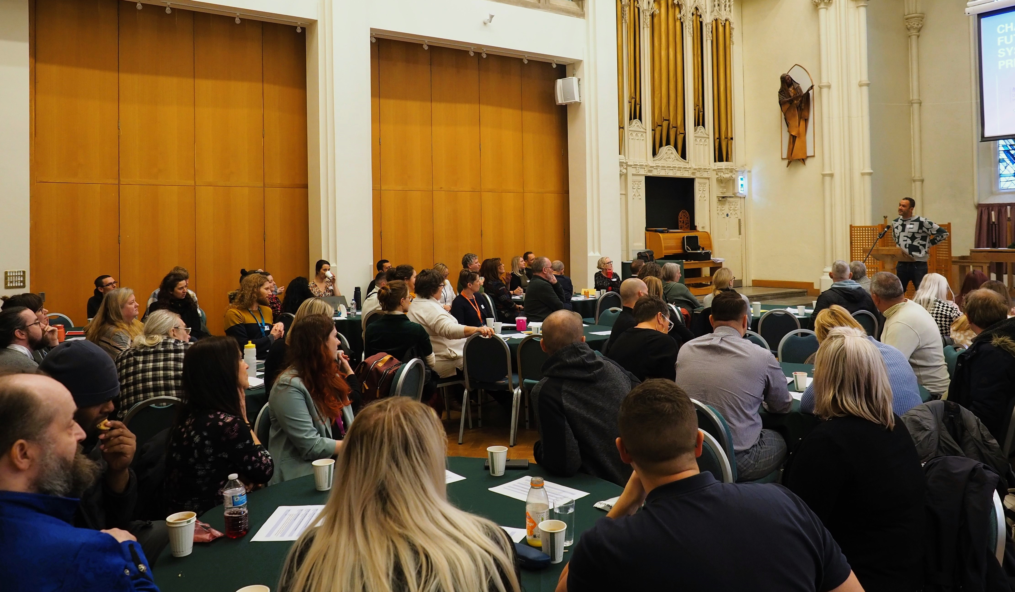

Changing Futures
£64m national (DHLUC) programme across 15 pilot site areas including Sheffield
Delivery mobilised in February 2022 and national funding ends March 2025
Core aims - change the systems and services who support adults experiencing severe and multiple disadvantage (affected by mental illness, homelessness and rough sleeping, domestic abuse and exploitation, substance abuse and crime)

Slide 3
Sheffield Programme Aims
Directly engage with and support positive outcomes for people identified as living with multiple disadvantage
Embed coproduction in the city, where people with lived experience are involved in the design, delivery and evaluation of services
Tackle and challenge health and social inequalities and promote inclusive services that make a difference to people’s lives
Promote and operationalise joint working across organisational boundaries
Develop learning about what works (both from Sheffield and other areas) to inform future strategies and service developments

Slide 4
2024 – 2025 Programme Delivery
Core Team: 10 Keyworkers, 2 Team Leaders, 2 Team Managers, Business Support
Positive Activities Fund
Learning and Development Service
Programme Management
Coproduction Service
Specialist Mental Health Services
Notes:
60-70 Associates

Slide 5
Changing Futures & Multiple Disadvantage
Substance Misuse Strategy
Police Crime Plan
Adult Safeguarding Strategy
Mental Health Partnership
Domestic & Sexual Abuse Strategy
Health & Wellbeing Strategy
Inclusion Health Framework (NHS)
Female Offender Strategy
Homeless Prevention & Rough Sleeper Strategy
Combatting Drugs Partnership
Safer Sheffield Partnership
SHSC Clinical and Social Care Strategy

Slide 6
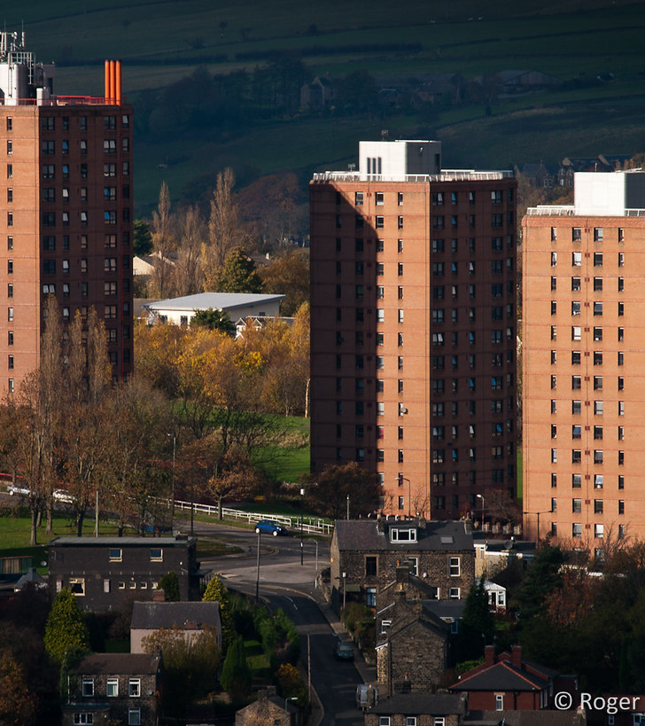
Changing Futures: Cuckooing
40% cohort have been affected by Cuckooing
Prevalence of individuals at risk of homelessness due to ASB high within our cohort
Anecdotally, Cuckooing was on the rise in Sheffield
Cuckooing became one of our system change workstreams

Slide 7
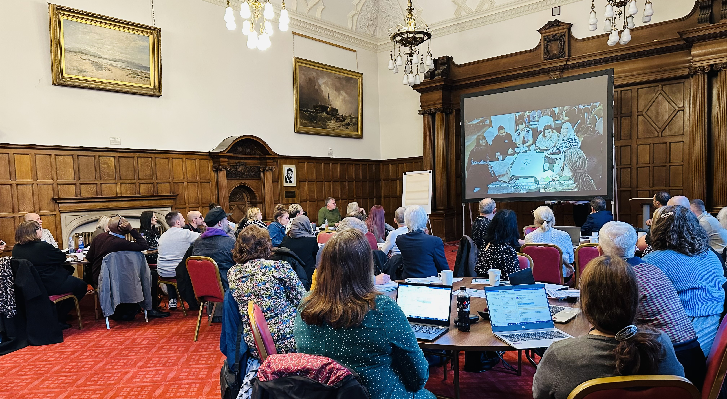
System Change Objective: Cuckooing
Developing a citywide strategic response to Cuckooing as linked to wider strategies for early intervention and prevention, care and support, community safety, and homelessness prevention and independent living
Developing a new multi-agency operational response model informed by best practice, evidence of need and successful outcomes
A more effective response will have a wider benefit to the range of public sector resources that are deployed in the city, including Housing, Care, the NHS, Community Safety and Criminal Justice.

Slide 8

System Change Objective: Cuckooing
In Sheffield, whilst good practice in response to incidents of Cuckooing has been identified, responses and outcomes remain inconsistent. Feedback from frontline practitioners and managers is that this is due to:
A lack of awareness across the wider Sheffield workforce
No agreed multi-agency responses or protocols in place
No strategic oversight of the issue
Notes:
At a multi-agency meeting in September 2022, whilst it was recognised that the issue appears to be increasing it was agreed that we required a better understanding of the scale and impact of the issue before developing this workstream any further

Slide 9
Evidence Based Approach
Data was extracted from multiple Sheffield City Council systems using ‘search functionality’. This pulled out records which included any mention of ‘Cuckooing’, ‘Cuckooed’ or ‘Cuckoo’.
These records were then manually checked to distinguish whether cuckooing was suspected, whether it was taking place, whether the record related to a victim or perpetrator and the nature of the cuckooing
Data sets were also requested from partner organisations across the city. These submissions were then cross referenced with the primary data set and duplicates removed
As Cuckooing is not explicitly recorded it is likely that in absence of explicitly recorded instances we have ended with a under estimation in terms of scale.

Slide 10
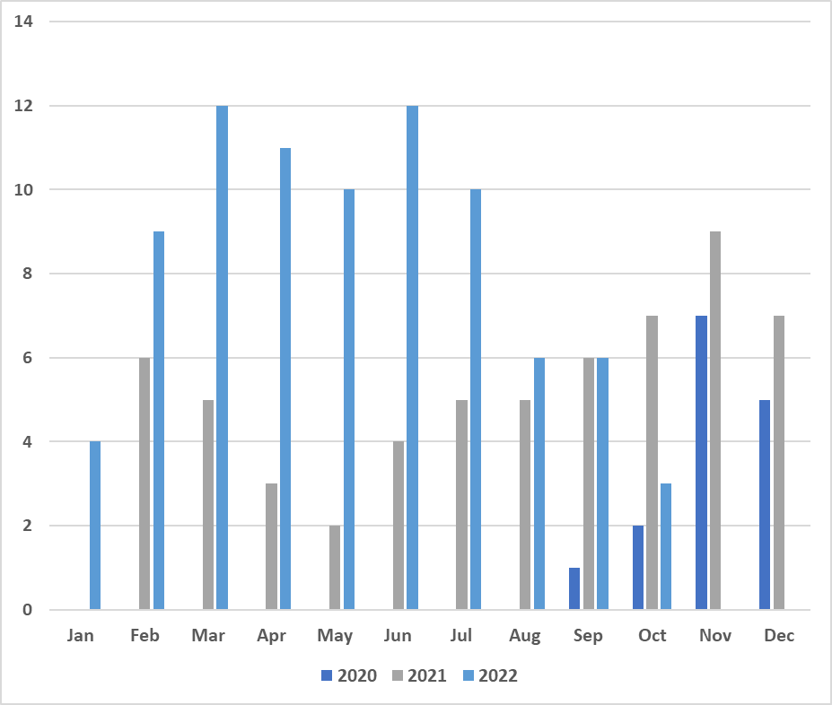
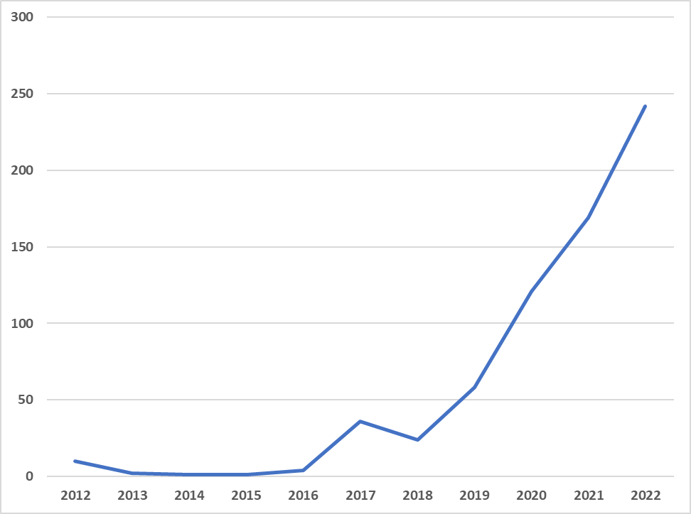
Evidence Based Approach
October 2020 – October 2022 – 166 individuals identified as victims
In 2022 there was a 43% increase in victims
Dates for the 166 identified victims – data collected in October 2022 hence reduction/absence in Nov/Dec 22
The number of records that include the word Cuckooing (inc. variations) in Sheffield City Council’s housing data system OHMS

Slide 11
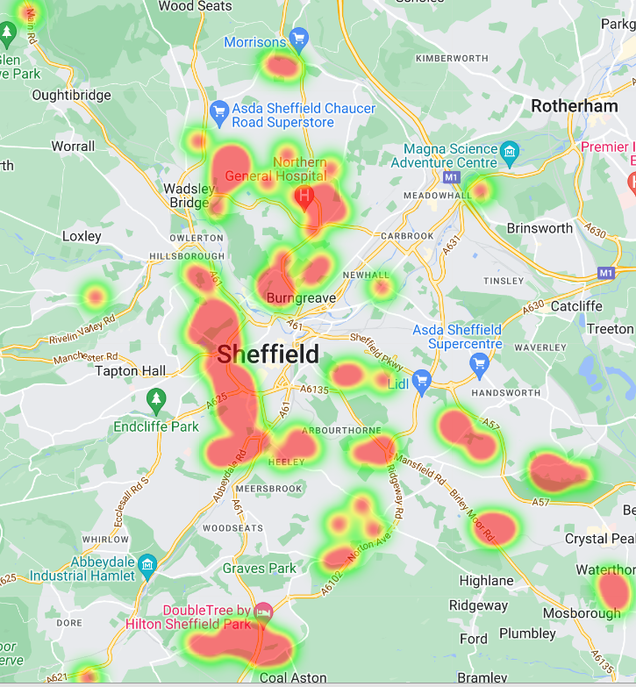
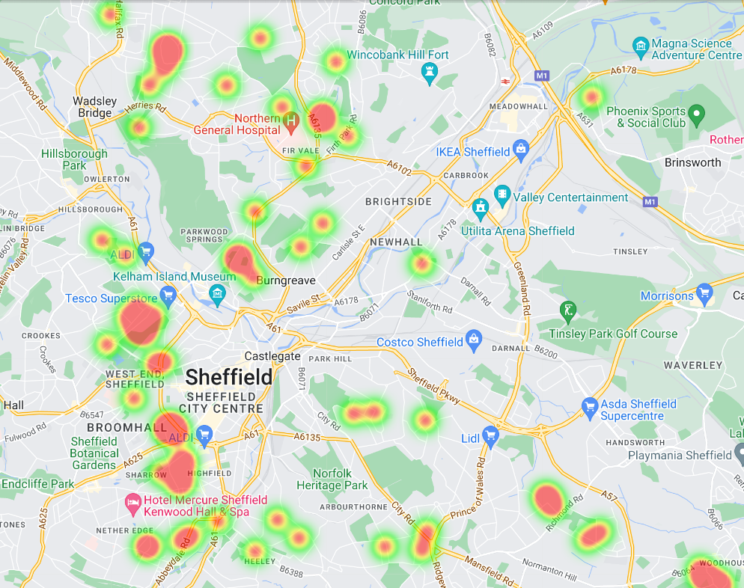
Evidence Based Approach
Notes:
There was a strong correlation between identified locations for Cuckooing and reported drugs crimes based on South Yorkshire Police crime data. These heat maps show where instances of Cuckooing were most prevalent.

Slide 12

Evidence Based Approach
Victim profile –
‘White British, aged 36-45 with a history of homelessness and current substance use & mental health support needs’
A significant proportion of women identified as victims were also known victims of Domestic Abuse
There is a risk that conflation between these concerns has resulted in an underreporting of female victims in relation to Cuckooing

Slide 13

Evidence Based Approach
We interviewed two individuals who had been Cuckooed:
https://youtu.be/KFaqFEhCEVI
https://youtu.be/SCc6JTnZrsw

Slide 14
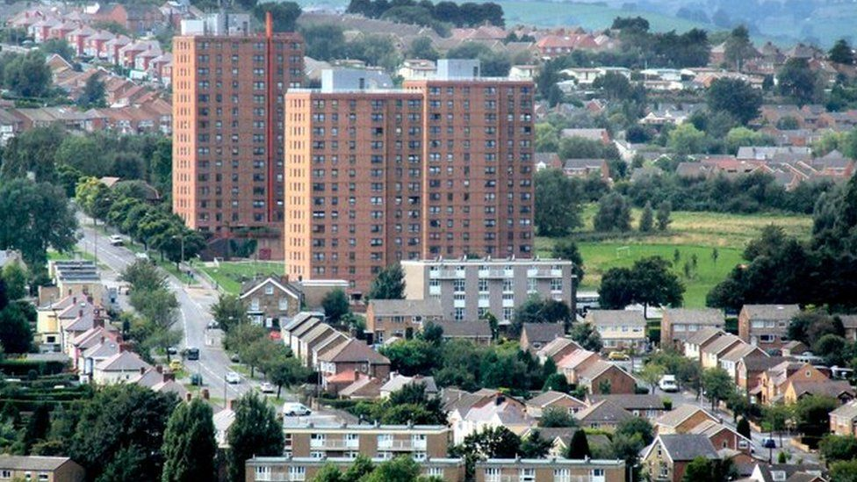
Project Approach
Work in partnership with all stakeholders internal and external e.g. SCC Commissioning Services, SCC Housing Services, social care, NHS, police, probation, social landlords and housing associations, private landlords and a wide range of care and support providers
Work in co-production with the customers of the service (residents of Sheffield)
The work has been steered by Sheffield’s FORTIFY Silver and the Sheffield Adults Safeguarding Partnership who provide:
  a strategic level oversight on delivering necessary actions
  broad knowledge, expertise and advice including horizon scanning
  direction on how to implement the agreed approach

Slide 15
Project Activities
Strategic oversight agreed as Safeguarding Adults Partnership and FORTIFY Silver Board
Developed and delivered training in collaboration with Shelter, Project 6, Community Safety and Changing Futures to housing officers within Sheffield City Council, social landlords and registered providers
Multi-agency workshop held on the development of a cross sector approach / protocol focused on responding to Cuckooing
Finalisation of approach agreed with three areas for further development outlined:
Data recording and reporting
2. Agreed designated escalation route
Designated multi agency resource to prevent and respond to Cuckooing

Slide 16
Project Activities
Cross city agreement that the Multi Agency Safeguarding Hub will be the designated escalation route for Cuckooing concerns related to victims. Training updated to reflect
Improvements to data recording agreed with SCC Housing Solutions, SCC Housing and Neighbourhoods, SCC Homelessness Service Providers, SCC Communities, SCC Adult Social Care, SCC Family and Childrens, Sheffield Health and Social Care Trust, South Yorkshire Fire Service, South Yorkshire Police
Finalised reporting process for the above partners to provide quarterly data on prevalence of Cuckooing to both the Sheffield Safeguarding Adults Partnership and FORTIFY Silver
Attended FORTIFY Bronze to discuss resourcing a designated Cuckooing multi agency team

Slide 17
How do we prevent victimisation and perpetration?

Slide 18
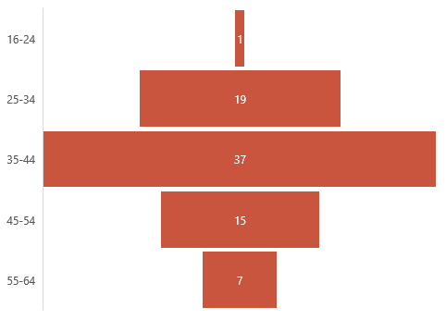
Beneficiaries Demographics
Notes:
Narrative: this is a group of individuals who are already costly to the system and whom the system will likely never work for – there is a commitment from services that this group may need some form of care for their adult lives due to their trauma and life experience (not be confused with lack of hope for some recovery)
Age range – this is a cohort who will experience declining health as they age quicker than general population if they don’t die

Slide 19
System Contacts Prior to Changing Futures
Notes:
Cohort’s contact with services increasing prior to Changing Futures
Need escalating or need consistent but becoming more visible to the system
Not visible in MH system prior to CF & HAST support

Slide 20
Housing Outcomes
Notes:
Success stories: getting people into high intensity / needs supported accommodation – CF being involved has facilitated this being successful

Slide 21
Housing Outcomes

Slide 22
Housing Outcomes
Notes:
Increasing capacity / throughflow in housing solutions

Slide 23
Domestic Abuse Outcomes
Current DA needs:
March 2022 – 53 people
December 2023 – 11 people
Notes:
Result of working intensely with perpetrators
For one individual – no DA offences perpetrated for over a year

Slide 24
Substance Use Outcomes

Slide 25
Individual Outcomes: Criminal Justice
 | Feb 2022 | Dec 2023
Open to Probation | 35% | 27%
Engaging with Probation | 79% | 86%
Notes:
Drivers – continuity of care on release from prison
No. of new convictions reduced but no. in custody maintained – people recalled and finishing sentence

Slide 26
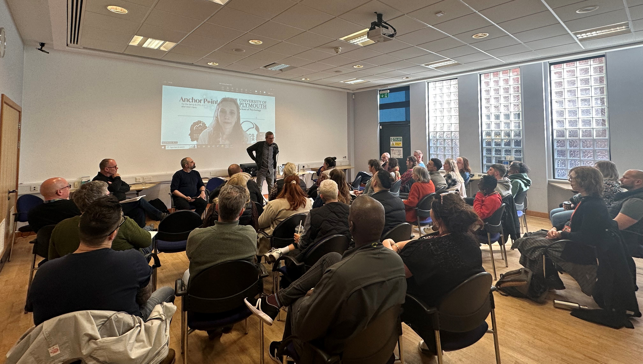
What have we learned so far?
Data collection processes take time to embed
Takes dedicated resource to coordinate strategic and operational responses
Having a service (Changing Futures) that sits slightly independent of other statutory and voluntary services in the City, can act as an ‘honest broker’ and be a ‘critical friend’ without prejudice across the system

