Slide 1
END STIGMA , CREATE SAFETY AND PROMOTE EMPOWERMENT
Jackie Blackburn | Amber Wilson

Slide 2
Basis Yorkshire - Adult Women 1 to 1 Support
Intensive casework
Complex Challenges
Housing First
&
DV & Housing
Basis Training
System Change
Mental Health
Transition & Adult
Exploitation
Basis
Young People
IDVA
ISVA

Slide 3
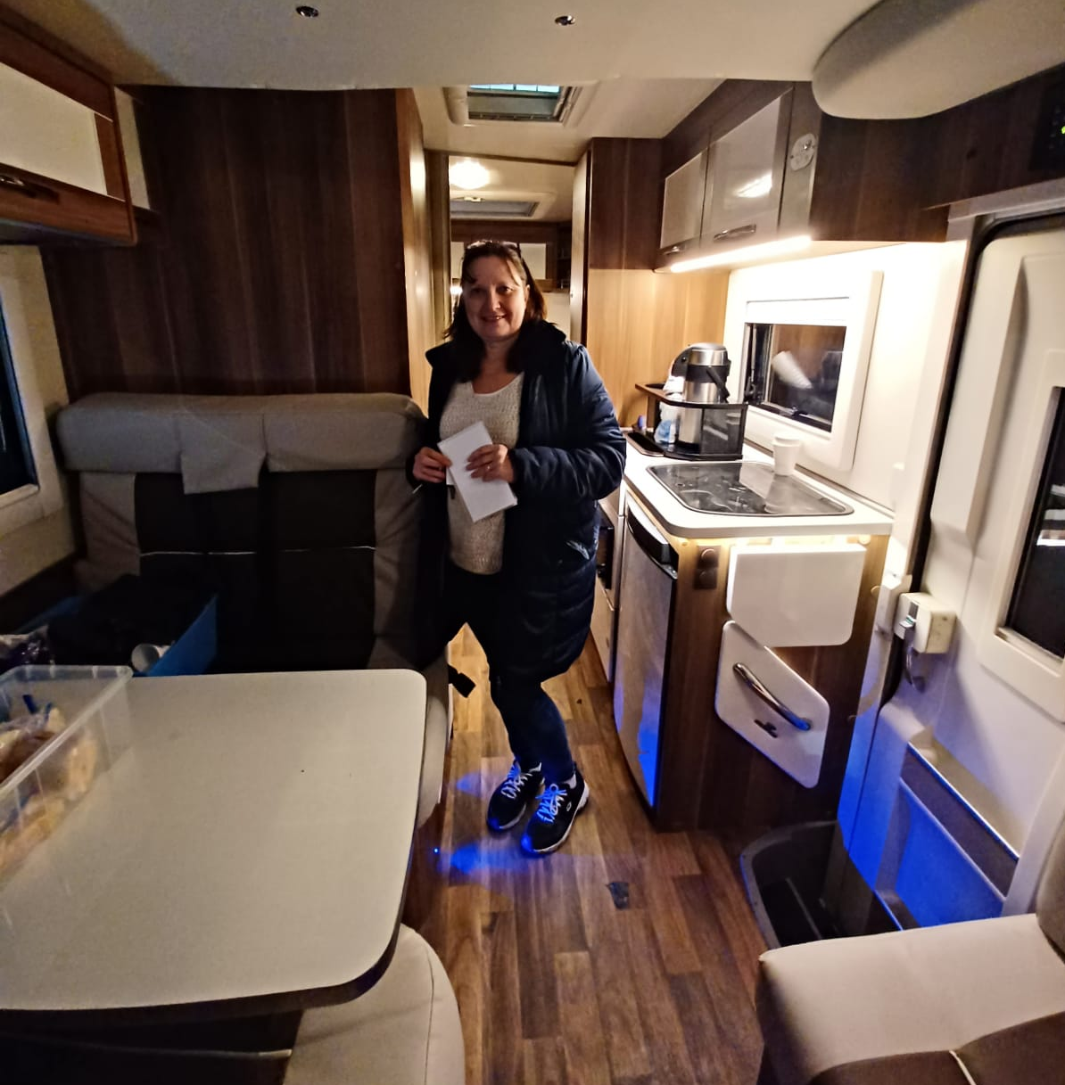
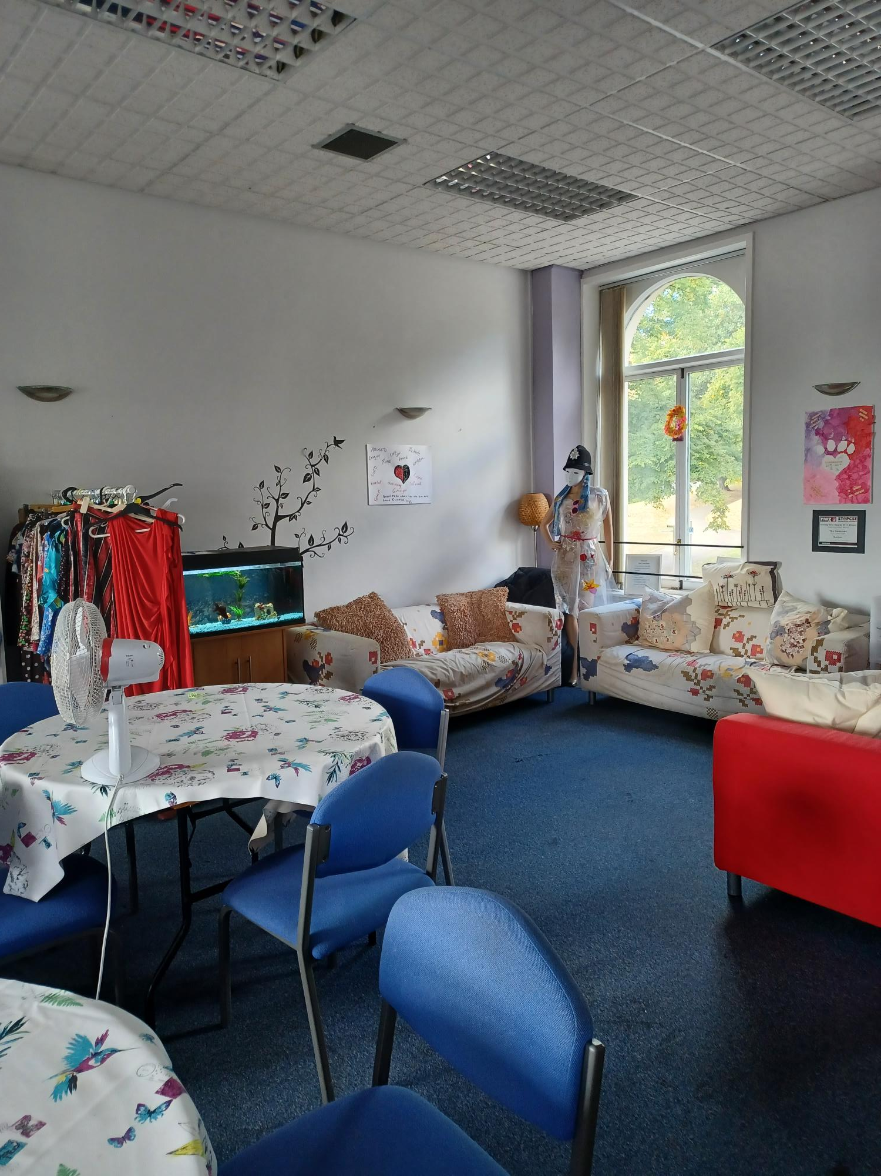
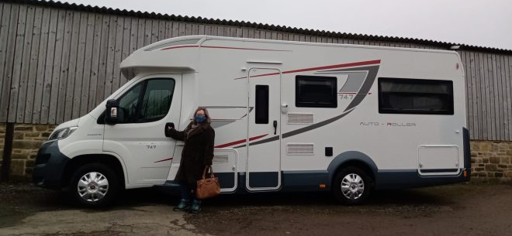
Basis Yorkshire - Group Support
Drop In (Basis office)
Mon | Tues | Wed (1-4pm)
Outreach (Holbeck)
Mon | Wed | Fri
(8 -10:30/11pm)

Slide 4
Background of women supported
Indoor and Street Sex work
Sexual Exploitation
Substance Abuse
Domestic Violence (repeated history)
High mental health needs due to:
Childhood Trauma (abuse)
History of removal of children
Sex work related Trauma
Social isolation
NO SUPPORT NETWORK
HIGHLY DISTRUSTING OF SERVICES
EXTREME LEVELS OF VIOLENCE

Slide 5
Barriers into services
Digital exclusion
Unstable and unsafe housing
Stigma
No ID
Registration process
Coercive control
No knowledge of processes
Addiction
No phone number
Not enough support or guidance
Discrimination
No social support network
Leaving prison without a worker

Slide 6
Cuckooing aka Financial, Emotional and Sexual exploitation
Targeting
Isolation/Fear/Control
Siolation
Cuckooing
Introducing to “friends” and drugs: criminalisation
Adult Exploitation!
Hold through drug debt and violence

Slide 7
Sex Work Vulnerability – street-based but not exclusive
“You don’t see us as the rest of the world sees us sometimes”.
-
Stigma
Social isolation
Drug addiction
Poor mental health
Low self-esteem
Dependant on social housing /emergency accommodation

Slide 8
What does it look like in practice?
Prevention:
Screening of property
Temporary move
Partial or Full Closure Order
New Property
PARTNERSHIP APPROACH WITH POLICE; ANTI-SOCIAL TEAM; HEALTH; HOUSING & SOCIAL CARE AND OTHER 3RD SECTOR

Slide 9
What does it look like in practice?

Slide 10
What does it look like in practice?

Slide 11
What it looks like in practice

Slide 12
Challenges and Successes
Challenges
Housing stock
Unmet need Mental Health
General resources across all services
Recognition of exploitation
Sex Work Stigma
Successes
Great partnership work
Flexibility to support
Pro-active approach to cuckooing

Slide 13
Thank you!
www.basisyorkshire.org.uk
Basis Yorkshire
@BasisYorkshire
@BasisYorkshire

