Slide 1




Understanding and Preventing
‘Cuckooing’ Victimisation in the North of England
Preventing and Disrupting
‘Cuckooing’ Victimsation Conference
30-31 January 2024
Dr Laura Bainbridge
18th December 2023 – YHROCU Crime Board
Preliminary Research Findings
*please do not share or cite without permission*

Slide 2

Event Information
A full programme for the conference is included in your delegate pack
Q+A at the end of each presentation
Refreshments and lunch
Fire alarm → congregate on the grass outside of the main entrance
Wifi access →
Network: Eduroam
Username: lawvis01@leeds.ac.uk
Password: Vis0300124
Powerpoint slides, recordings and a conference report will be uploaded here
X hashtag → #EndCuckooing

Slide 3

Any questions?

Slide 4

Understanding and Preventing
‘Cuckooing’ Victimisation in the North of England
Understanding and Preventing ‘Cuckooing’ Victimisation
Dr Laura Bainbridge & Dr Amy Loughery
31st January 2024
Dr Laura Bainbridge
18th December 2023 – YHROCU Crime Board
Preliminary Research Findings
*please do not share or cite without permission*

Slide 5
The Study (Impact-Focussed)
Funding: N8 Research Partnership
Co-production: South Yorkshire Police; Durham Constabulary, North Yorkshire Police, Humberside Police, West Yorkshire Police, Merseyside Police, Cumbria Police and the West Yorkshire Violence Reduction Partnership
Research questions:
RQ1: How, when and why are ‘cuckooing’ victims targeted?
RQ2: How is ‘cuckooing’ experienced by victims and perpetrators?
RQ3: How can ‘cuckooing’ be prevented and disrupted?
Data collection methods:
1) Collation of 500+ publically available and redacted internal documents
2) 60+ semi-structured interviews with cuckooing experts (national, regional, local levels)
3) Timeline interviews with cuckooing victims and perpetrators (graphic elicitation)

Slide 6

Outputs and Events
April 2022 – January 2024
→ Understanding and Preventing Cuckooing Victimisation Symposium - May 2023
→ A menu of tactical options for local delivery groups → January 2024
→ Summary report for wider dissemination → January 2024
November 2023 – July 2024
Collaboration with West Yorkshire Police, Leeds City Council and Beacon Leeds
Creation of a Cuckooing Research & Practice Network
Network conference → 30th and 31st January 2024
Network Symposium → June 2024
Co-delivery of cuckooing awareness raising sessions
Co-production and evaluation of a cuckooing toolkit / risk assessment form
for housing providers
Understanding and Preventing Cuckooing Victimisation: County Lines and Beyond
Will be published by Routledge in December 2024

Slide 7
Risk Factors (1)
.
Victims of cuckooing are habitually targeted by County Lines operatives because of their vulnerability, which may be
multi-dimensional or temporal (e.g. grief following a bereavement).
Primary targets for cuckooing perpetrators are those who suffer from drug or alcohol dependency, have
a physical disability, a mental health condition and/or a learning disability.
Other risk factors include:
Being in recovery from alcohol or drug dependency
Neurodiversity or brain disorder (e.g. dementia)
Financial insecurity (poverty)
Young adults living alone for the first time
Housing insecurity and homelessness
Loneliness, social isolation and/or lack of support network
Age (i.e. older people)
Being a lone female parent experiencing emotional or financial difficulties
Involvement in sex work
A history of being in the care system / being a recent care leaver
Present or prior experience of neglect, physical and / or sexual abuse
Connections to those who are vulnerable (e.g. the homeless; substance users) and/or those involved in street gangs or County Lines activity
… higher education students?

Slide 8

Risk Factors (2)
.
Interview data indicates that the White men, aged between 18-50 years, are victims that regularly come to the attention of police and safeguarding agencies
Cuckooing victims often reside in socially deprived areas, and live alone in either a) a block of flats, or b) a house that has back alleyway access. Such properties are typically managed by registered social landlords
Functioning addicts that are not subject to police, housing or adult social care attention
are attractive cuckooing candidates to perpetrators as they are likely to be less chaotic,
disruptive and ‘shielded’ from exploitation
Knowledge Gap(!)
Private sector rented accommodation and owned properties are not immune from cuckooing activity.
Intelligence and research in relation to these property types is, however, lacking at present
“… these organised crime groups, the offenders that do this, they’re not silly about it. I do think they do their due diligence; they do their research. They know what kind of person or what houses [..] have worked before and then they look for that again”

Slide 9
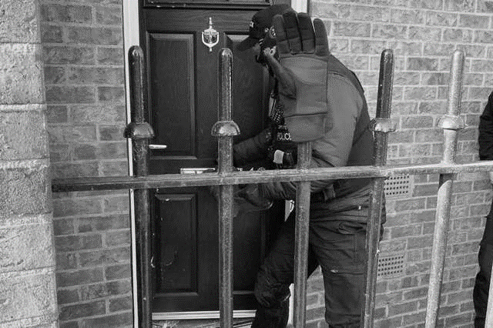
Pathways To Victimisation (1)
.
Interacting with potential cuckooing victims is a relatively straightforward enterprise for perpetrators. While each perpetrator has their own modus operandi, findings suggest that the following strategies are recurrently adopted to locate and target potential victims:
Visiting sites where drug-users regularly congregate (e.g. abandoned properties) and having conversations with those purchasing drugs about their housing situation, or that of their friends, family, acquaintances or neighbours
Calling-in a fabricated debt – i.e. ‘we bought you alcohol last week, you owe us, you need to let us into your flat’
Idling in deprived areas with the aim of identifying those with mental health issues
Loitering outside of drug and alcohol treatment premises, and approaching service users or following them home
Sending out a ‘we need a place to crash’ message via text/social media
Utilising existing knowledge of vulnerable people with their own neighbourhood (aka. ‘beginning of line’ or ‘local’ cuckooing)

Slide 10
Pathways To Victimisation (2)
.
Alternative strategies include:
Waiting in Hospital Accident and Emergency Departments with the aim of identifying those displaying drug-seeking behaviour (e.g. those demanding opiates; benzodiazepines; and antipsychotics)
Waiting outside of pharmacies to engage with those collecting methadone scripts
Approaching people as they visit food banks or Jobcentres
Striking up conversations in cafes with those displaying signs of loneliness i.e. somebody nursing a cup of tea for several hours
Befriending single men, or female members of the church community
Information sharing between OCGs may also occur.
For example, if a repeatedly cuckooed home is unexpectedly unavailable, a suitable replacement may be recommended by non-competing County Lines operatives

Slide 11
‘Relationships’
.
  Cuckooing often commences with adult grooming
  Victims may be approached in a friendly manner, with efforts made to swiftly build trust and rapport
The complex interpersonal relationship that is formed between victim and the perpetrator is often accelerated
→ particularly when the victim is neurodivergent, lonely or dependent on drugs and/or alcohol
Perpetrators may be charming, and are likely to have honed their manipulation skills over time
Offering the victim something of interest to them is a dominant strategy of cuckooing perpetrators
E.g. a romantic relationship, friendship, sex, protection, food, expensive fashion items, an electric scooter,
a designer breed dog, alcohol, money and/or drugs
In return, the perpetrator will then request ‘a favour’ – typically, a place to stay for a few days, a place to meet their friends, or the storage of items.
Some County Lines operatives are transparent about why they require use of the victim’s property (i.e. to facilitate drug dealing) while others make excuses as to why they require use of the victim’s home
Where victims are aware that their property will be used for criminal purposes → negotiation

Slide 12
Behind Closed Doors
.
Once a perpetrator has gained access to a property, the relationship between the victim and the perpetrator often deteriorates rapidly, although this is not always the case
Some victims are unaware that they are being exploited, and believe that the perpetrator(s) is their ‘mate’
→ reluctant to engage with police and safeguarding agencies due to feelings of loyalty to the perpetrator
→ There is some evidence to suggest that young people and female perpetrators have acted as cordial houseguests
For other victims, the ‘benefits’ offered by the perpetrator swiftly begin to reduce over time and may be terminated entirely
For those unaware that the perpetrator is a member of an OCG the takeover of their home can be particularly distressing
For the majority of victims, feelings of betrayal, confusion, shame, anger and fear prevail
→ exacerbated by the intimidation, (death) threats and violence that is initiated when victims ask the
perpetrator(s) to cease dealing or leave their home
Debt bondage

Slide 13


Forced Entry
.
Forcing entry to a property is not a preferred method for County Lines operatives
Where this does occur, the threat or use of violence is customary, and the property is likely to:
be the home of an individual that is already known to the perpetrator - either because of previous contact or because they or one of their relatives owe the OCG money
be known to OCGs as an address that is used by a registered social landlord to house a vulnerable person. The victim may be tailgated when they enter their property
Data confirm that cuckooing perpetrators have also taken-over victim’s back gardens via forcing entry

Slide 14
Covert Cuckooing
.
The behaviour of perpetrators when they occupy a property seemingly reflects the level of ‘professionalism’ of the OCG
Discretion is paramount for those working for astute OCGs – they deliberately avoid drawing attention to themselves by coming and going quietly, and/or dealing in alternative locations (e.g. woods, parks, cars)
Signs that low-key OCG operates have engaged in a home takeover can include:
The victim not being seen by neighbours for a while
People remaining in the property while the victim is out
Unfamiliar people driving the victim’s car, or being driven by the victim
Curtains or blinds being closed during the day
Gardens becoming overgrown
Children and young people with no known connection to the victim are seen entering the property

Slide 15
Overt Cuckooing
.
Other OCGs are less cautious, and opt to deal directly from the cuckooed property thus creating a closed or indoor drugs market. When this occurs, indications of their presence can include:
An increase in the number of visitors to a property, with visits being brief in duration and occurring around the clock
An increase in bikes, mopeds and vehicles (including taxis and hire cars) arriving at the property, or parking close by
People arriving in expensive cars (e.g. BMWs)
Groups of people congregating in front gardens or at the back of a property
An increase in litter outside of the property, including takeaway boxes and discarded drugs paraphernalia (e.g. foil, syringes, cling film)
External doors being propped open
Damage to doors and windows
Unknown people pressing buzzers to gain access to buildings
Graffiti
An increase in theft in the local area

Slide 16
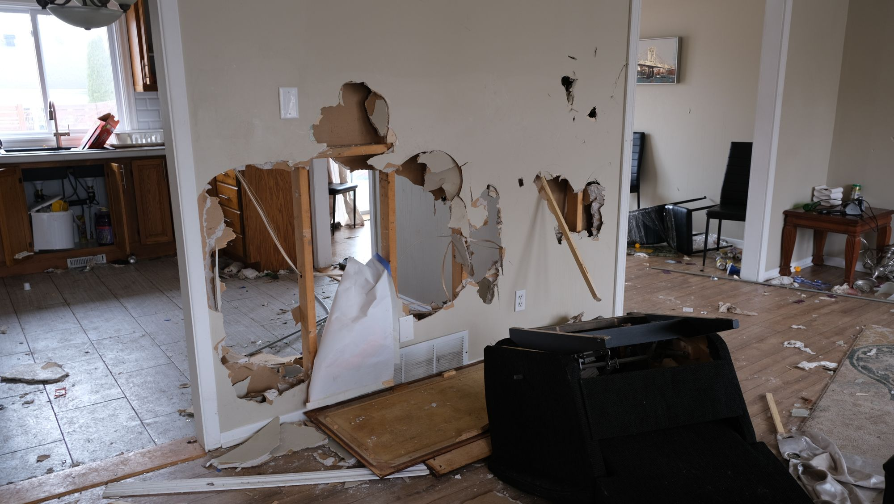

Slide 17
Prevention and Intervention
Specific ‘Cuckooing’ Legislation
Holds the potential to provide legislative clarity. But(!) may fortify enforcement/legalistic approach and may criminalise ‘unideal’ victims
Awareness Raising
Specific training for Neighbourhood Policing Teams, including engagement with the College of Policing
Training and awareness-raising activity with police partners (‘know the signs’). VR. Short animation. Workshops
Professionals who have access to properties may be key (e.g. property maintenance workers; meter readers; safety inspectors (e.g. fire alarms, gas boilers); community nurses; midwives; Specsavers home visits)
Those who may encounter County Lines operatives and cuckooing victims (taxi/Uber drivers; A+E workers; GPs; mental health and addiction specialists; those who work in local shops; cafes; pharmacies; post offices and takeaways)
Encourage professional curiosity (e.g. why does a tenant keep losing their key; increased use of fob)
Early intervention in secondary schools re. County Lines and exploitation
Public awareness raising (e.g. social media; cinema ‘adverts’ – similar to Modern Slavery agenda) – but, is this educating perpetrators?
Information Gathering and Mapping
Specific cuckooing flags on police and safeguarding systems (victim; perpetrator; addresses).
Regular multi-agency meetings (RAG rating victims and potential victims) – what are the facilitators and constraints to moving from amber to green? How, why, when and where is displacement occurring? Safeguarding of new care leavers
Risk Terrain Modelling
Police should consider feedback mechanisms re. information provided via partner portals (i.e. ‘the void’)

Slide 18
Prevention and Intervention
Adoption of Target Hardening / MARAC Safeguarding Measures
Clear, Hold, Build at a neighbourhood and individual level. Medium rather than short-term approach
Offer ‘refuge’ to victims for a few days (e.g. via The Salvation Army)
NRM referral if appropriate
Regular welfare checks and police patrols
Cucooning and/or leaflet drops in surrounding properties (4x4)
Informal no-guests notice or Partial Closure Order (is signage in the best interests of the victim?)
Panic alarms; Hollie Guard; SmartWater; door spy holes; video doorbells; secure locks, doors and windows; new SIM cards to prevent contact (private-sector collaboration); higher fences; mobile CCTV; lighting (streets and passage ways); alley gates
360 degree support offered (e.g. addiction; housing; mental and physical health; Local Area Coordinators)
Move to a new property (with victim’s consent) – exchange arrangement with other Housing Providers?
Safeguarding Non-Cooperative Victims
Which organisation is best placed to lead? Who has/had the strongest relationship with the victim?
Fear should not be a driver for engagement (e.g. threat of losing tenancy) – re-isolation and feeling of being trapped (suicide)
Regular welfare checks (not police)
Duty to Notify referral?
Sensitive Lets / Cuckooing Risk Assessment Tool(s)
Housing shortage means that vulnerable people may be housed in high-risk areas
Assess risk, deliver tenant education re. exploitation (simple language and messaging – your home is your safe space; no such thing as a free pizza) and ensure multi-agency safeguarding mechanisms are in place
Uncooperative Private Landlords → warn may be complicit in organised crime and may face prosecution

Slide 19
For further information, please contact:
Dr Laura Bainbridge
Lecturer in Criminal Justice
School of Law
University of Leeds
L.Bainbridge@leeds.ac.uk

