Slide 1
Summer Lane Estate
Problem Solving Plan
Preventing Cuckooing &
Disrupting Organised Crime Group B27
Paul Davies Senior Officer
ASB/Housing Safer Neighbourhood Services

Slide 2
Objective
Using a problem-solving approach (OSARA) to disrupt, deter and prevent drug dealing by Organised Crime Group (OCG B27), prevent cuckooing and safeguard vulnerable victims on the Summer Lane Estate Barnsley.

Slide 3
Council what can we do?
Council have a statutory obligation to tackle OCGs
Councils have a unique part to play alongside police and partner agencies to tackle SOC (OCGs).
Need to identify/understand local vulnerabilities
Provide intelligence and share data
Notes:
The Renters Reform Act abolishes the use of a Section 21 eviction notice however the Act strengths landlord possession grounds by creating new grounds, amending existing grounds and removing some.
The new grounds are:
1a. The sale of a property: Tenancy agreements must have been in place for at least 6 months and this ground cannot be used if the tenancy was issued under the Rent Act or Agricultural Rent Act
6a. Allows possession in order for the landlord to comply with enforcement action as it would be unlawful for the landlord to maintain a tenancy agreement. This could be following a refused/revoked license; the number of tenants exceed the maximum number of tenants for the property or either a banning order, an improvement notice for overcrowding or a prohibition notice has been served on the landlord
8a. Repeated rent arrears where a tenant within the last 3 years has been in either 8 weeks/2 months of arears on at least 3 occasions
The amended grounds are:
1. Occupation of the landlord to now include close family. Tenancies must be in place for at least 6 months and it must be the landlord/family member’s principle home
8. Rent arrears. The original rent arrears ground can still be used where the tenant is in 2 full months of arrears at the time the notice was served and the date of the court hearing however the notice period has been increased to 4 weeks and if a tenant falls into 2 months of arrears due to unpaid UC payments if their claim has been stopped due to a change in circumstance or a new application has been submitted these rent arrears are not to be included
14. Anti-social behaviour. This ground has been widened to include behaviours ‘capable of causing’ nuisance or annoyance
The repealed grounds are:
3. Holiday accommodation which prevents landlords from evicting a tenant in order to use the property as a short let/holiday accommodation

Slide 4
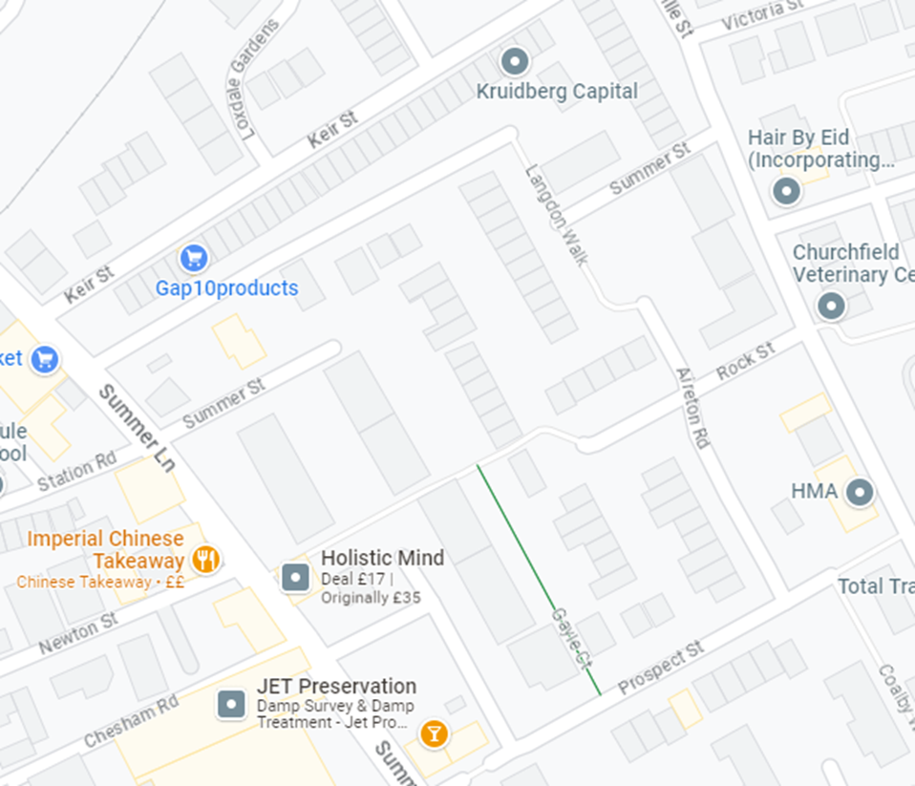
Scanning
The Summer Lane Estate is situated in
central Barnsley close to the town centre.
Predominantly Berneslai Homes properties.
Number of criminal tenants in properties.
Number of vulnerable tenants with
(mental health, alcohol and drug issues)
Known ASB & drug hot spot area.

Slide 5
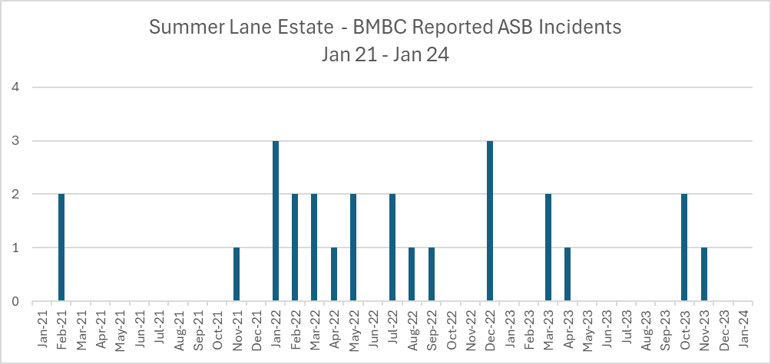
Scanning

Slide 6
Problem Analysis Triangle
Summer Lane Estate
OCG B27
Drug Users
Vulnerable Residents
BMBC/Berneslai Homes/Police

Slide 7
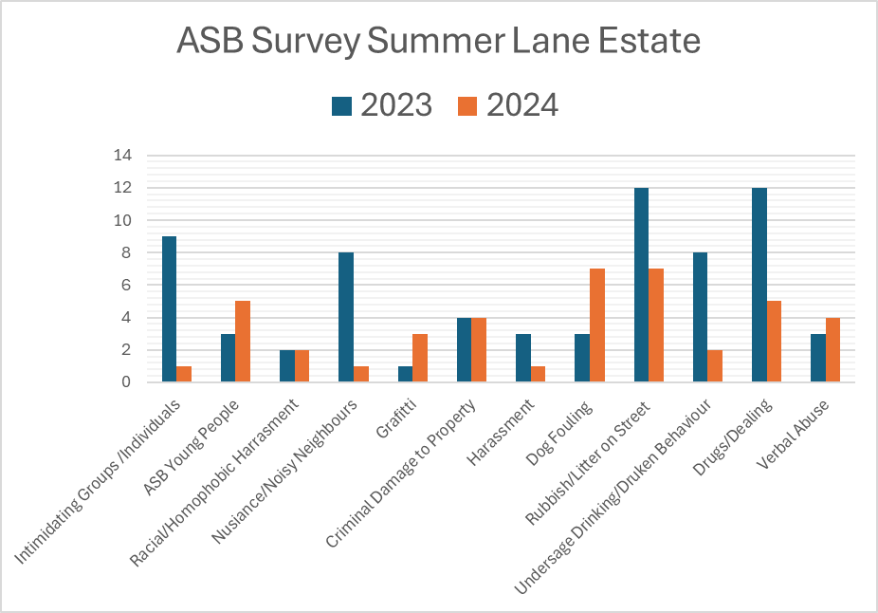
Analysis
Decrease in Drugs/Dealing.
Increase in dog fouling & ASB young people.

Slide 8
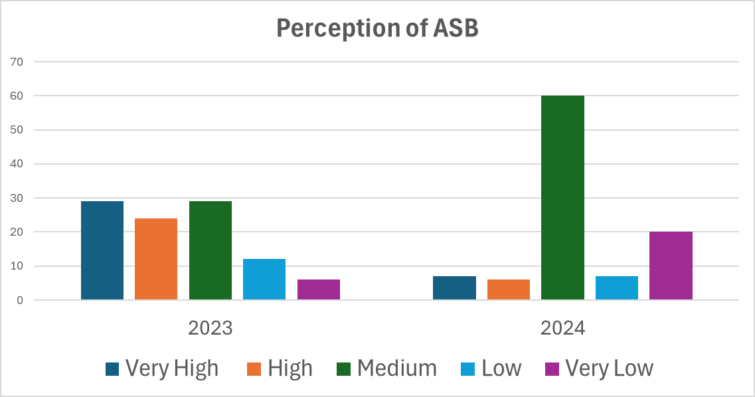
Analysis
Marked reduction in in perception of ASB being Very High and High.
Survey dates 1 year & 2 days apart.

Slide 9
OCG B27 identified as being involved in drugs supply
OCG B27 using properties of vulnerable tenants
Town Centre nominals visiting estate to buy drugs
High number of cases involving cuckooing
Increase in crime and ASB on the estate
Increase in support required by victim witness support
Increase in requests to move Berneslai Homes properties

Slide 10
Response
Close collaborative working between BMBC SNS, Berneslai Homes & SYP key to tackling the estate issues.
OCG Bronze Group Meetings/MAAG/PACT/Professionals Meetings
First 3 closure orders were in place within a 6-week period
Estate issues targeted on Op Duxford (Joining Forces)
Knowledge sharing on the locations, addresses and nominals and the outcomes required

Slide 11
Actions on Discovering a Cuckooing Victim
Closure order obtained
National Referral Mechanism (NRM) completed
Support from Berneslai Tenants First
Allocated priority move from SLE
Adult Safeguarding
Vulnerable Adult Panel
Victim & Witness Support Officer

Slide 12
Council Actions:
6 x Civil Injunctions completed banning OCG members from Barnsley/Summer Lane Estate (BMBC)
7 x Closure Orders granted (BMBC)
3 x Notice Seeking Possession (BMBC)
5 x Community Protection Warning (CPW) (BMBC)
2 x Community Protection Notices (CPN) (BMBC)
3 x National Referral Mechanism (Modern Day Slavery) (BMBC)
3 x Possession Orders granted (1 x Mandatory Grounds) (BMBC)
Design Out Crime & CCTV Installed x 6 Cameras on the estate
5 Vulnerable tenants referred to Victim Witness Support (BMBC)
Submitted Intel Reports for (BH/BMBC)

Slide 13
Police Actions:
5 x Police Warrants executed under MDA
25 x use of search powers under Sections 17, 18 & 32 PACE
Submitted Intel Reports
Increased Stop and Search
Joint visits with Council and Berneslai Homes

Slide 14
Community Actions
Community centre on Prospect Street now in use. Being used by Creative Recovery for arts and music. Courses being run to help with mental health issues.
£2m in regeneration funding obtained by Berneslai Homes.

Slide 15
Assessment
Positive disruption around OCG B27 & reduction in drug dealing on the estate
Vulnerable tenants identified (Prevent Cuckooing)
Properties identified as being used for drugs sales – closed quickly (2 weeks)
Issues discussed at MAAG, OCG Bronze & Berneslai Homes meetings
Berneslai Homes properties on SLE are now ‘sensitive let’
Regular estate visits with HMO, SNS, Police & wardens

Slide 16
Why Closure Orders?
Immediate impact on reducing visitors to an address
Reduction in ASB & Crime
Allow agencies to gain access/engagement to tenant if vulnerable (Cuckooing)
Mandatory grounds for possession if closure order breached
Positive public perception

Slide 17
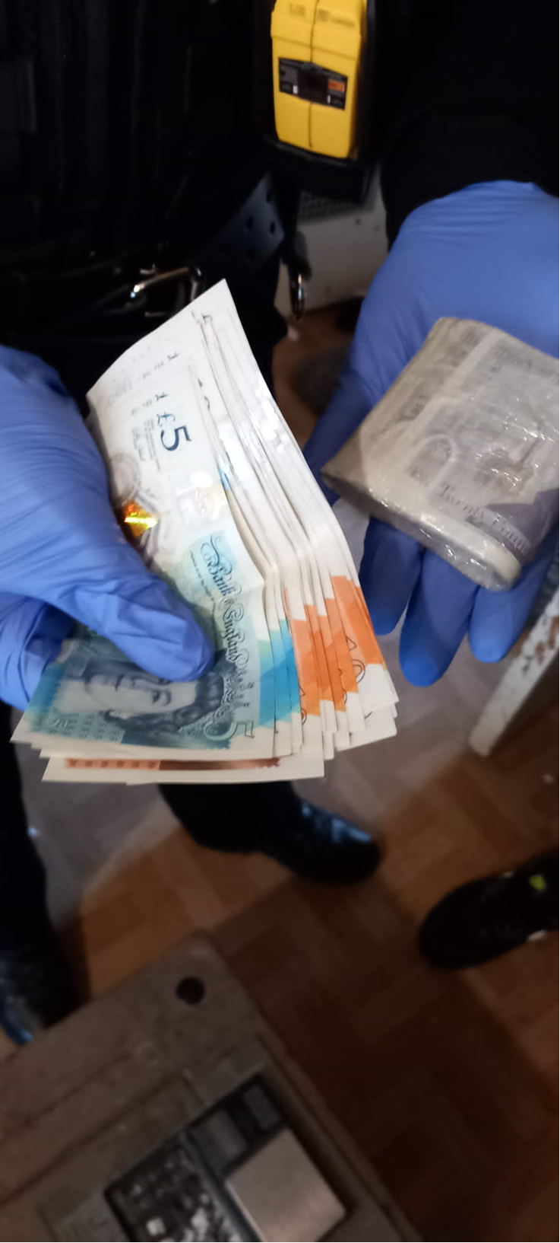
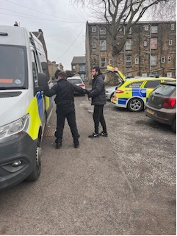
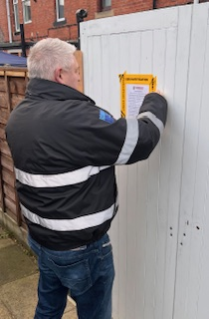
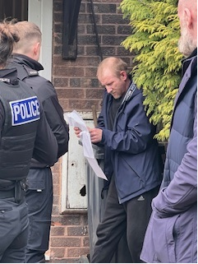
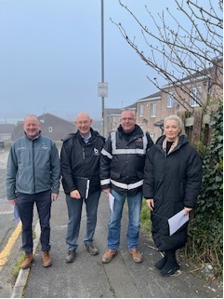
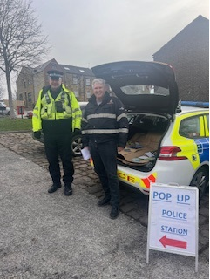
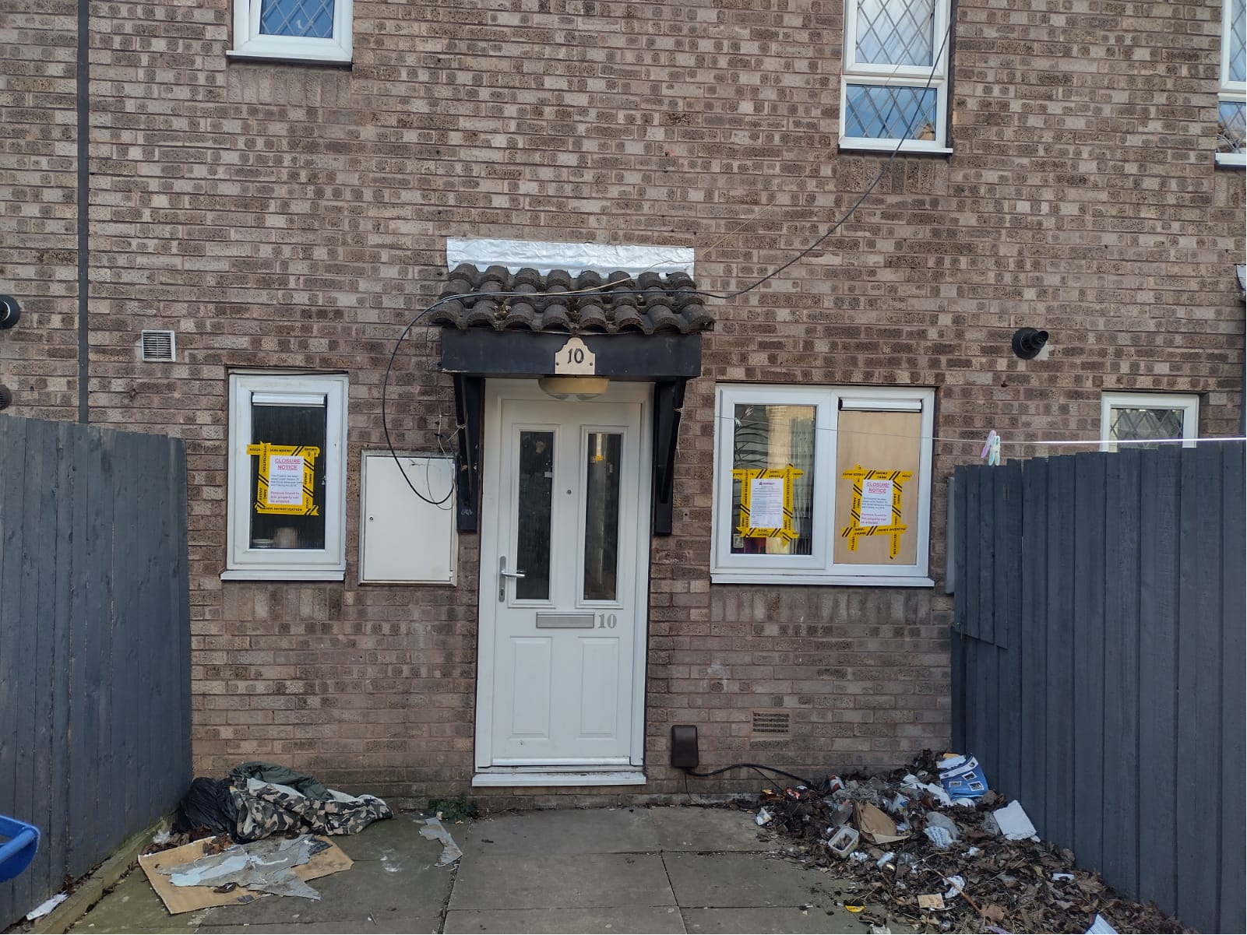
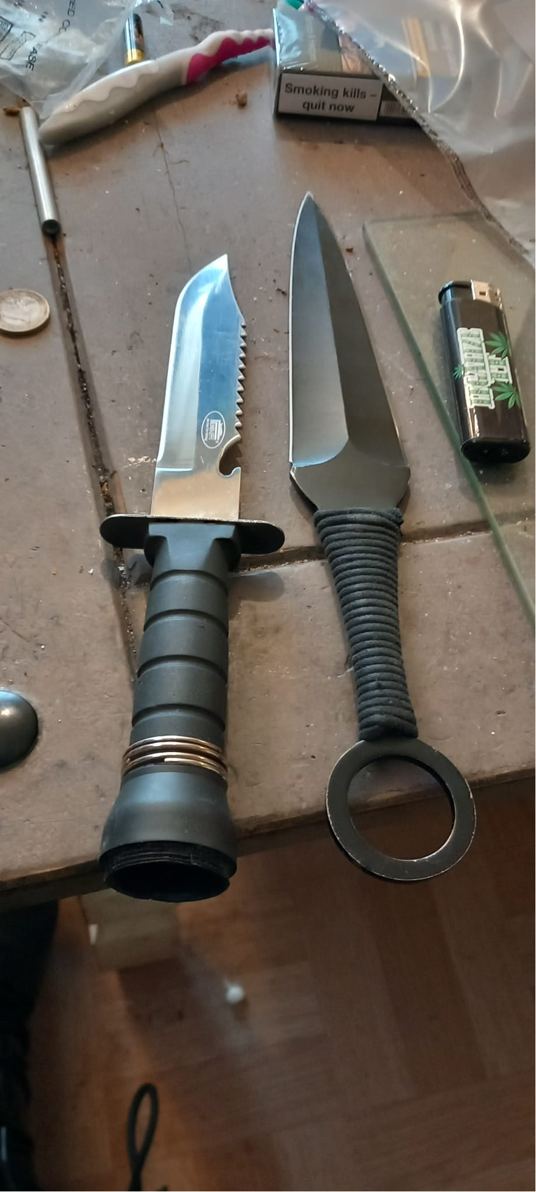

Slide 18
Learning
When it goes wrong (Case Study Jordan)
Lack of intel being submitted by BMBC and Berneslai Homes
Difficulties in enforcing closure orders (Lack of use of police powers)
Lack of NRM submissions and understanding
Funding (CCTV)
Sustaining and driving enforcement action
Displacement of dealers and drug activity

Slide 19
Thank you!
Any Questions???

